Slide 1
Another Look at the Four Horsemen of the Apocalypse
Maj. Tom Baird (ret.)
Prof. Tom Mack (ret.)

Slide 2

Understanding the Book of Revelation
Contrary to what many scholars think, the Book of Revelation was written between A.D. 40 and A.D. 68 by John Mark, the author of the Gospel of Mark.
He started the book by revealing a vision of Yahushua (Jesus) he received when he was still very young.
This revelation impressed the Apostles enough that he was directed to continue. They likely even raised funds to buy papyrus (paper) to assist his effort.

Slide 3
The Seven Letters
When a few sheets of papyrus was delivered to John Mark, he returned to prayer and being a scribe, he found himself recording seven letters dictated by Yahushua (Jesus) personally.
Since five of the seven letters were critical of the seven assemblies in Asia Minor, he though the Apostles would end the project at this point.
The Apostles agreed with the letters and commissioned John Mark to continue.
It should be noted though that much of the Eastern Orthodox Churches do not accept the Book of Revelation.
Even Martin Luther considered the book confusing.

Slide 4
Financing Revelation
Since the Apostles only met every seven years, getting John Mark more papyrus would have to wait. Finally, in A.D. 46, they raised money for more papyrus. They likely decided that future purchases would be overseen by Peter, Paul, and John.
Financing Revelation would have to be done by the assemblies. In practice, John Mark’s family would end up doing much of the financing.
John Mark’s family was from the Tribe of Benjamin, they were the scribes that copied Torah scrolls. He kept busy doing that, but when the papyrus came, he went to prayer.

Slide 5
A Visit to Heaven
At first, I think the Apostles thought the Book of Revelation would be Yahushua giving them directions on how they should lead their assemblies.
The next Revelation would shock even John Mark. The other Apostles had been to heaven at various times, but he was not an Apostle… yet!
Yet this visit to heaven was not a normal visit. Since he was a scribe, he had a message to bring, and Yahushua wanted him to bring it.

Slide 6
A Visit to Heaven
When he is first there, he describes what he has seen. This is for authentication, as he should see what they have seen. Yahushua knew the Apostles would be skeptical because John Mark was considerably younger than his Apostle counterparts.
After he described Heaven (Revelation 4), they got down to business. John Mark was shown a book with seven seals on it. Those seven seals could only be broken by Yahushua (Revelation 5).

Slide 7
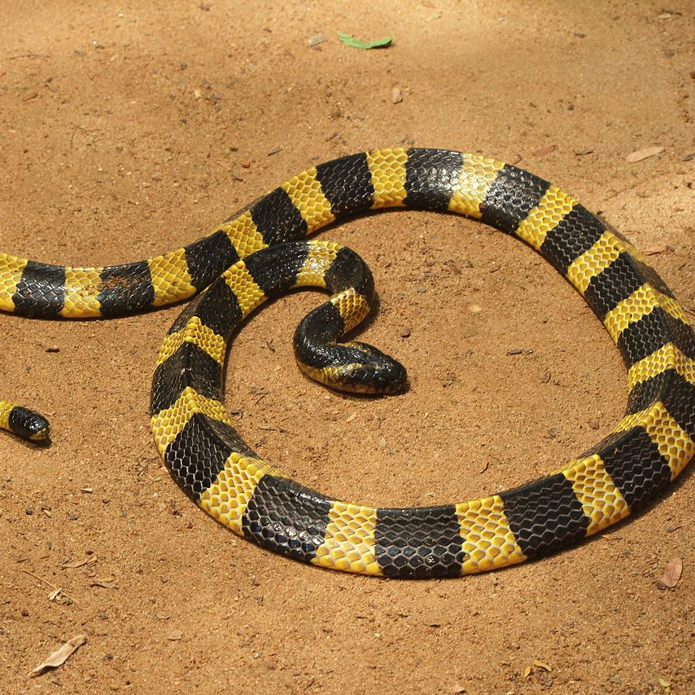
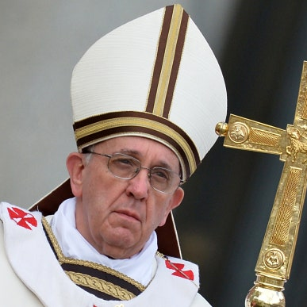
Breaking the First Seal
And I saw when the Lamb opened one of the seals, and I heard, as it were the noise of thunder, one of the four beasts saying, Come and see.
And I saw, and behold a white horse: and he that sat on him had a bow; and a crown was given unto him: and he went forth conquering, and to conquer. (Revelation 6:1-2)
The Greek Word for bow is τόξον (toxon). It is likely that John Mark questioned this word, but was told that in the end times, people would understand it.
The Greek Word for crown is στέφανος (Stephanos). Some have suggested it is the gold band on the Pope’s mitre. However, some Kraits (a poisonous snake in Asia) also have a gold band.

Slide 8
The COVID-19 Pandemic Comes to the World
The White Horse of Toxon
But is it Really a Virus???

Slide 9
Breaking Down the First Seal
And I saw, and behold a white horse: and he that sat on him had a bow; and a crown was given unto him: and he went forth conquering, and to conquer. (Revelation 6:2)
Scholars have argued over this verse for a long time. Traditional Roman Catholic Church scholars saw him as a coming world leader.
They saw the bow as the weapon he would use to conquer the world.
The word toxin was not employed until the 19th century when a doctor first used it in a medical paper.

Slide 10
Breaking Down the First Seal
And I saw, and behold a white horse: and he that sat on him had a bow; and a crown was given unto him: and he went forth conquering, and to conquer. (Revelation 6:2)
Dr. Bryan Ardis, D.C. has done many videos to demonstrate that the genetic structure of the COVID-19 is identical to the venomous toxin of a King Cobra or Krait snake, interestingly found only in Asia.
French researchers found that the venom in Cobra had 19 specific toxins found in COVID-19.
Could this be a new concept???

Slide 11

Breaking Down the First Seal
And I saw, and behold a white horse: and he that sat on him had a bow; and a crown was given unto him: and he went forth conquering, and to conquer. (Revelation 6:2)
Released in July of 1973 by NBC Television, this movie is about a research scientist named Dr. Carl Stoner (Strother Martin) who is doing research on venomous snakes.
He hires college student David Burke (Dirk Benedict, remember him from the A-Team) as his lab assistant and unwitting test subject.

Slide 12
Breaking Down the First Seal
And I saw, and behold a white horse: and he that sat on him had a bow; and a crown was given unto him: and he went forth conquering, and to conquer. (Revelation 6:2)
As David Blake starts getting injections, he starts to show the attributes of snakes, the most notable being the shedding of his skin.
Eventually, he becomes one of Dr. Stoner’s mistakes.
At the end of the movie, Dr. Stoner uses his perfected injection to turn himself into a snake.

Slide 13
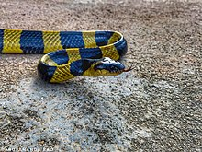
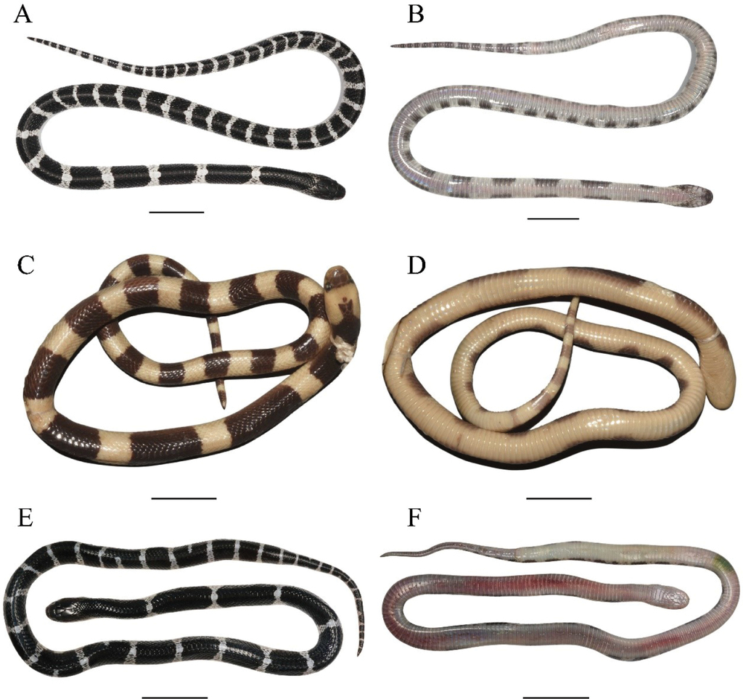
Breaking Down the First Seal
And I saw, and behold a white horse: and he that sat on him had a bow; and a crown was given unto him: and he went forth conquering, and to conquer. (Revelation 6:2)
It is unprecedented in history to have lockdowns of the magnitude of COVID-19.
Even today, Shanghai and other Chinese cities are in a state of lockdown.
Travel restrictions and “vaccine passports” are required for world travel.
What happens when the vaccines do not work???

Slide 14
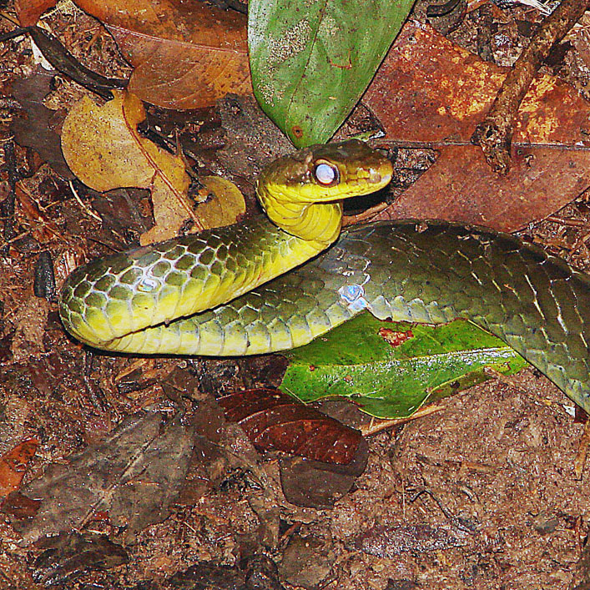
Breaking the Second Seal
And when he had opened the second seal, I heard the second beast (like a calf) say, Come and see.
And there went out another horse that was red: and power was given to him that sat thereon to take peace from the earth, and that they should kill one another: and there was given unto him a great sword.
(Revelation 6:3-4)
Red = πυῤῥός (purrhos) having the color of fire, red
To take = λαμβάνω (lambanō) to take or seize
Peace = εἰρήνη (eirēnē) a state of tranquility
Great = μέγας (megas) great, large in size
Sword = μάχαιρα (machaira) a small sword, as distinguished from a large sword, we get our word machete from this word. Also, named for the Machete Snake found in South America. It is non-venomous.

Slide 15
The Second Horse Rides
Now that the world is Poisoned,
they are ready to be eliminated

Slide 16
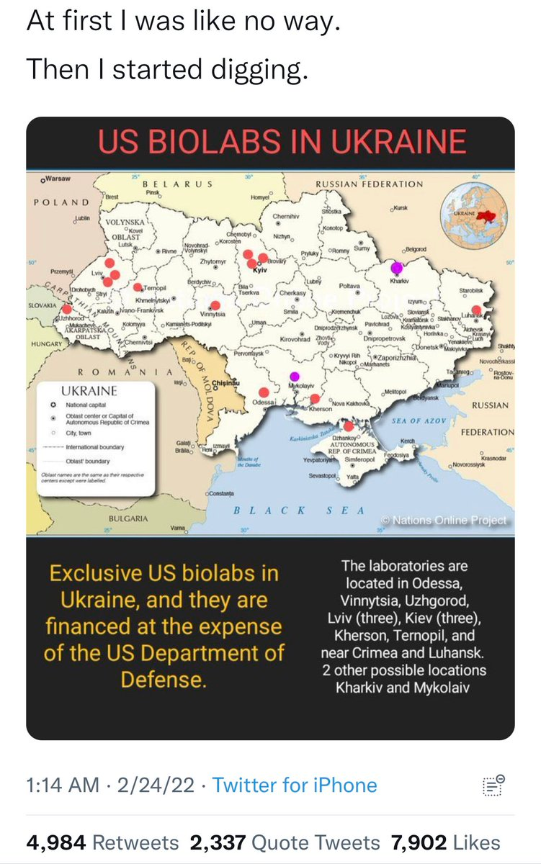
Breaking the Second Seal
And when he had opened the second seal, I heard the second beast (like a calf) say, Come and see.
And there went out another horse that was red: and power was given to him that sat thereon to take peace from the earth, and that they should kill one another: and there was given unto him a great sword.
(Revelation 6:3-4)
The Elements of 21st Century War
Even aggressive nations must be provoked into war. Russia went into Georgia in 2018 to confiscate biolabs. President Trump did not object.
Russia is in the process of retaking Ukraine, once a province of the Soviet Union. NATO has objected and sent aid to Ukraine.

Slide 17
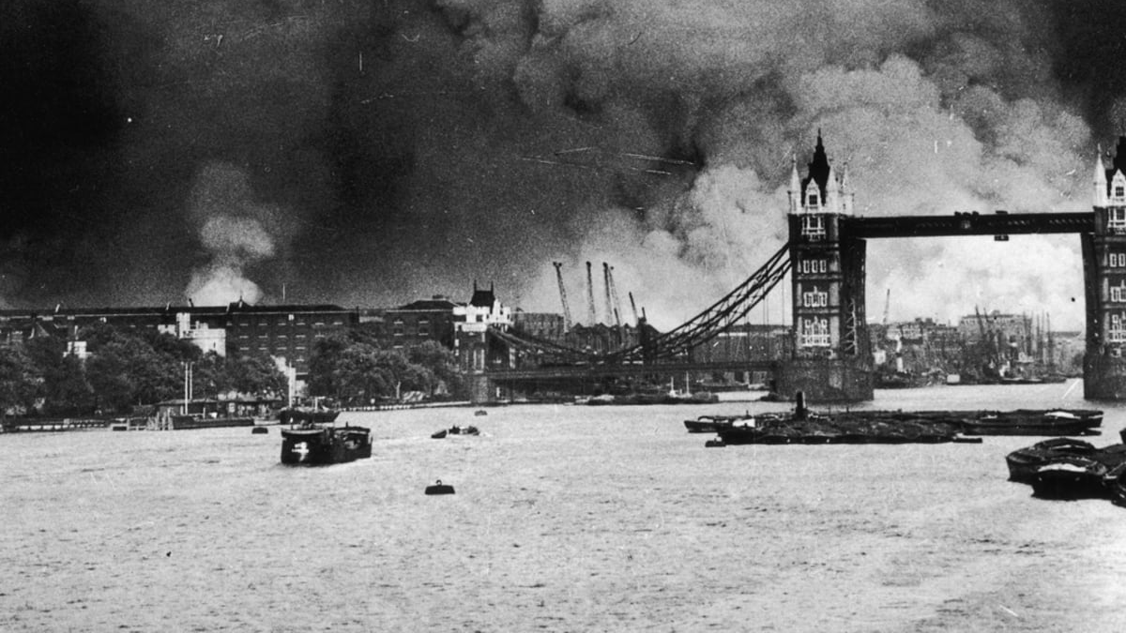
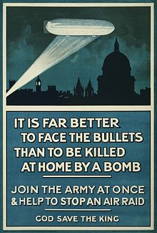
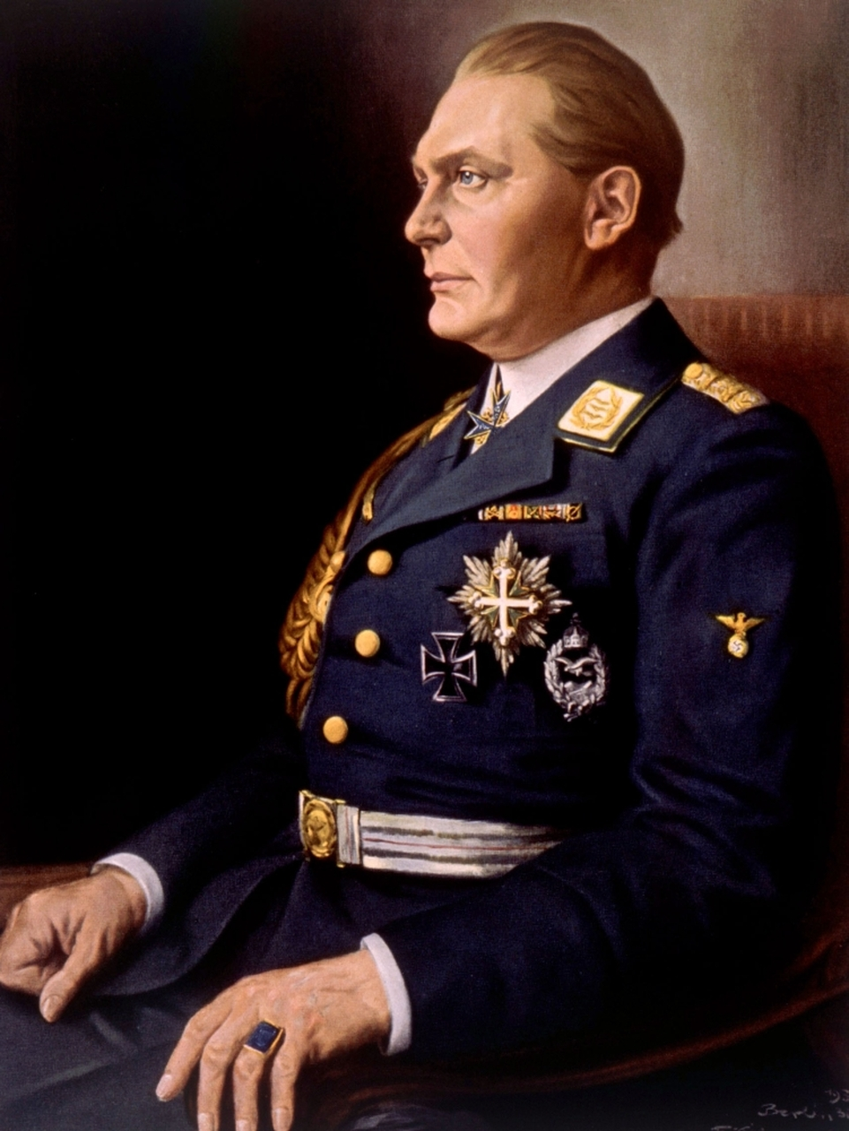
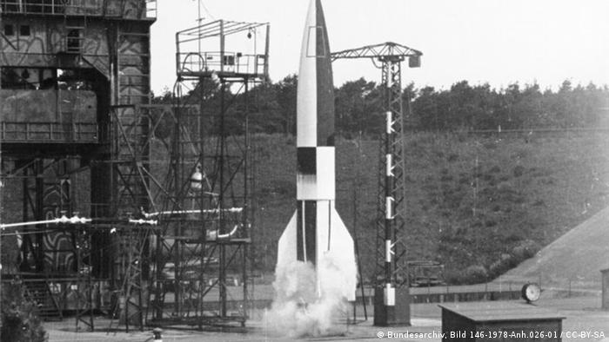
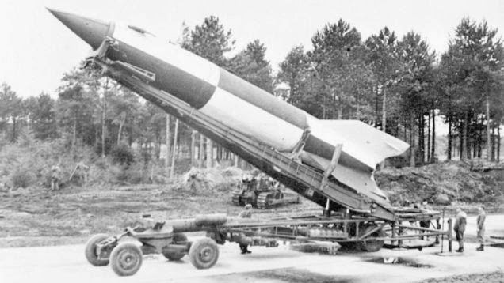
20th Century Warfare
World War I and II were total land wars.
The Germans used Zeppelins to bomb England in World War I.
The Germans during the London Blitz (1940-1942) attempted to destroy Great Britain’s Will to Exist. Reich minister Herman Goering claimed he could bomb Great Britain into submission.
When Germany could not succeed with airplane attacks, they used V-1 and V-2 Rockets to attack Great Britain.

Slide 18
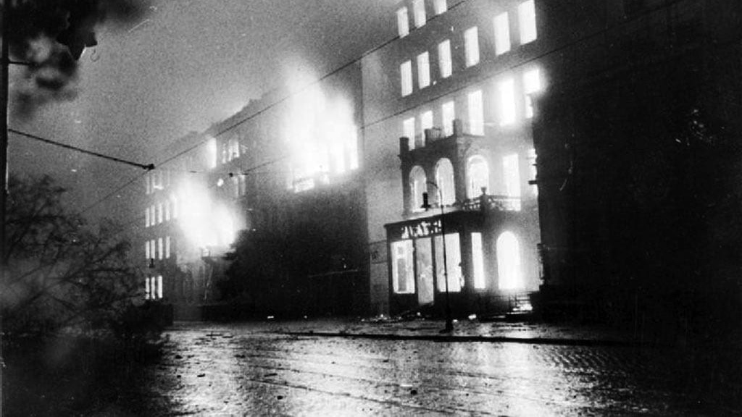
20th Century Warfare
World War I and II were total land wars.
Great Britain in retaliation for the Zeppelin Attacks and the London Blitz, used firebombing campaigns to level cities like Hamburg, where the Germans maintained their submarine pens. The Germans relocated their submarine pens to the Canary Islands far out of reach of the British and improved their radar technology.
Great Britain used massive night bombing raids on German cities to convince Germany to get rid of Hitler and end the War. The United States Army Air Corps did daylight bombing raids on factories and other more strategic targets. Effectively, Germany was getting bombed 24 hours a day.
In April of 1945, they fire-bombed Dresden, a city destined to fall into Russian hands a few days later. The reasons for bombing this city was never disclosed to the public.

Slide 19
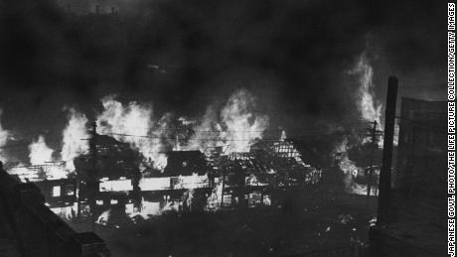
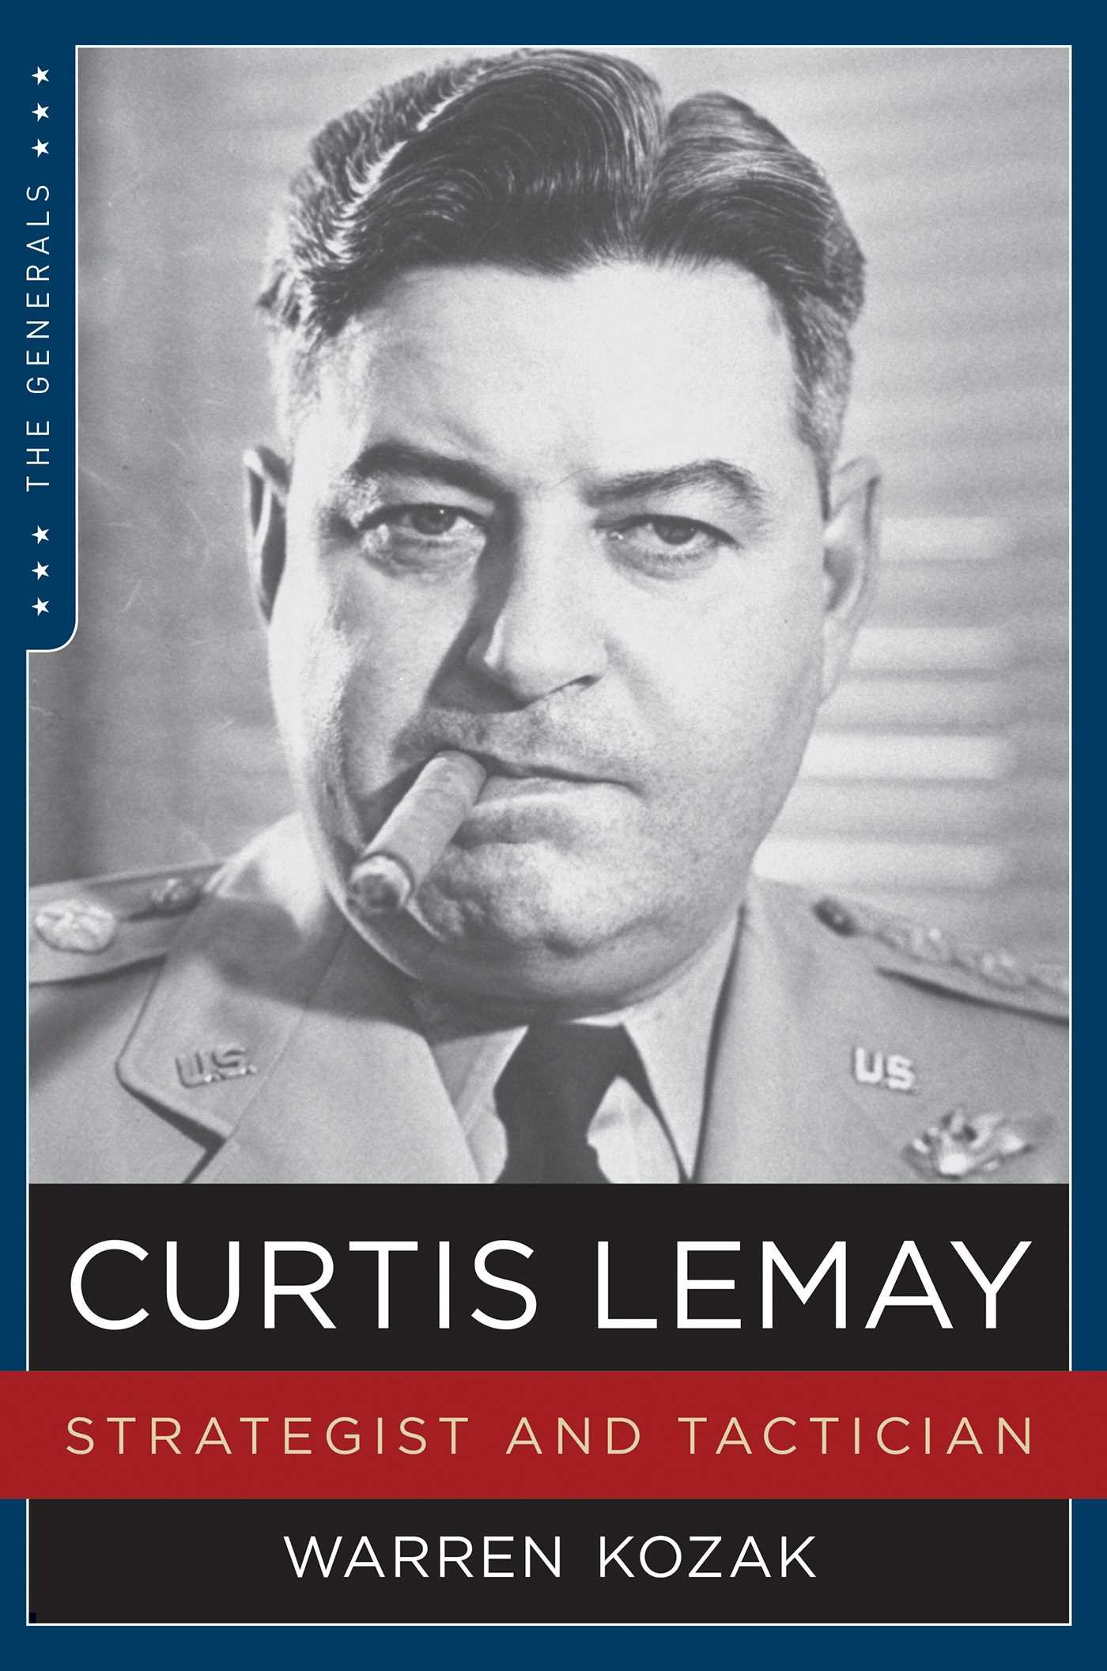
20th Century Warfare
World War I and II were total land wars.
In Europe, the United States engaged in precision daylight bombing raids on the German “means of production.”
The Germans responded by moving their manufacturing underground, away from American and British Bombing.
When General Curtis LeMay discovered that the Japanese had weak air defenses on the main islands, he used incendiary bombs and torched Tokyo. 100,000 civilians were killed in the raids. His raids eliminated most of Japan’s war infrastructure.
His most notable attacks was the Atomic Bombings of Hiroshima and Nagasaki.
He was later commander of the Strategic Air Command and finished his career as Air Force Chief of Staff.

Slide 20
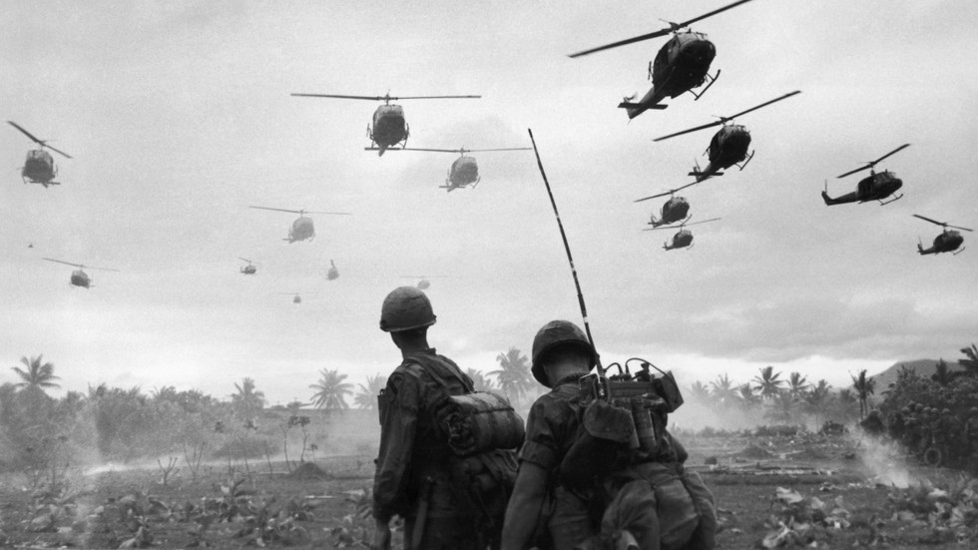
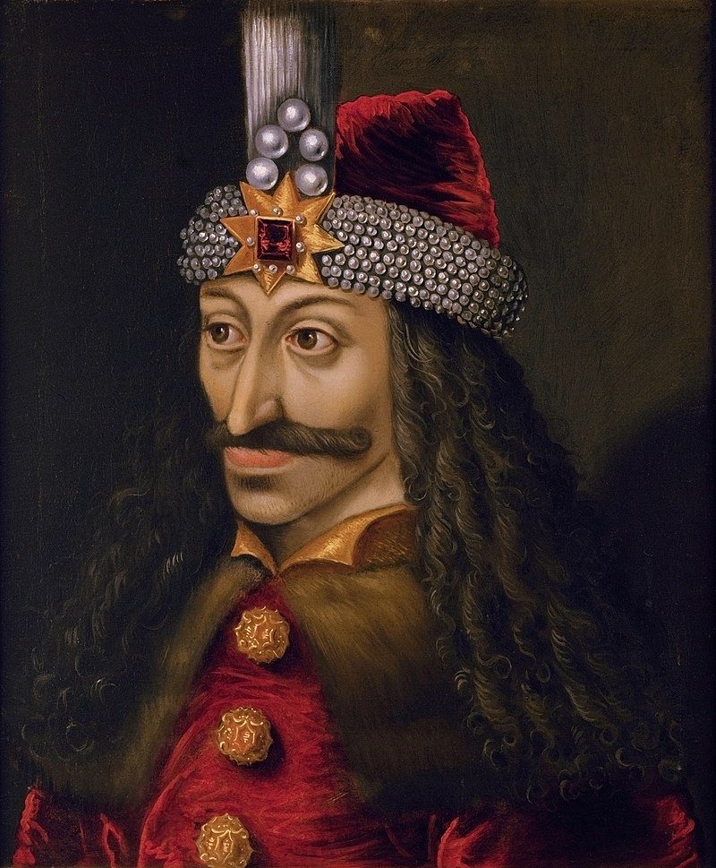
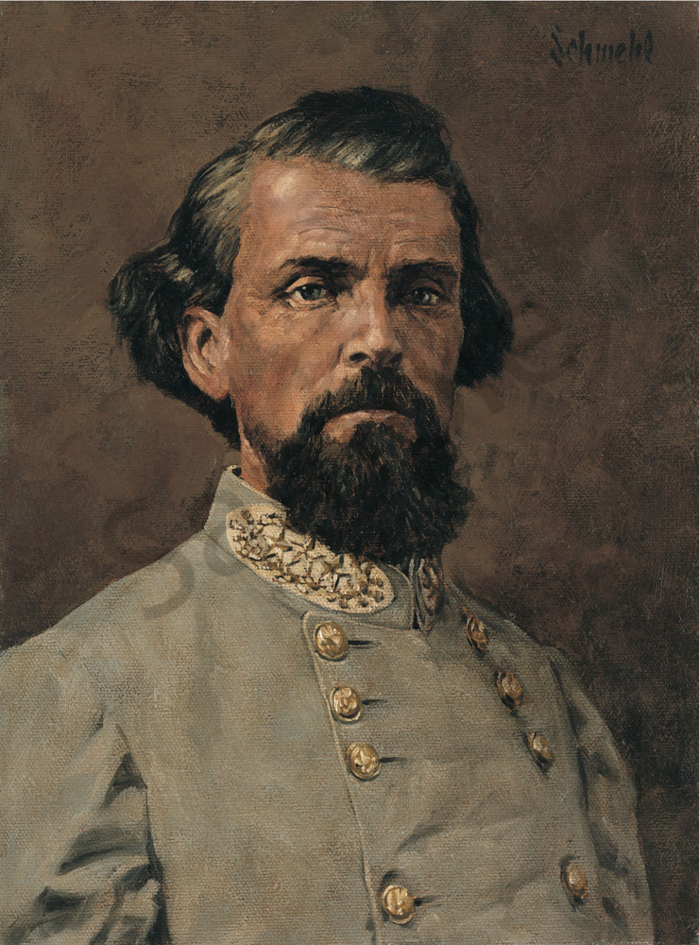
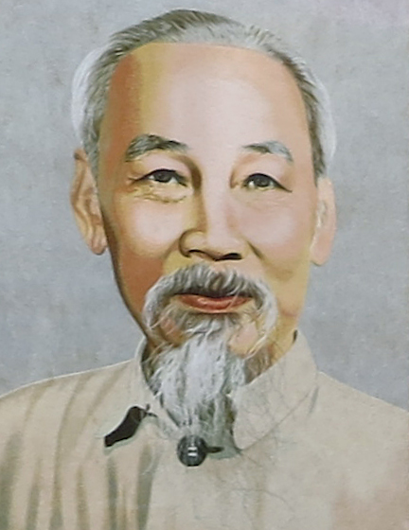
20th Century Warfare
Korea and Vietnam were Extensions of the Planning and Tactics of Previous Wars.
The first true instance of guerilla warfare came in the 15th century when Vlad Tepes used a “scorched earth” programs and guerilla warfare tactics to repel the Ottoman Turks who were invading his part of Romania.
The Russians would employ “scorched earth” tactics against Napoleon, Metternich (Austria), and Nazi Germany to repel invasions.
However, in Vietnam, we began to see the application of guerilla warfare, which Americans had first seen in the U.S. Civil War by Southern General Nathan Bedford Forrest, later a founder of the Ku Klux Klan.
The tactics were employed by Ho Chi Minh, Fidel Castro, Che Guevara, and other Communist leaders in Vietnam, Cuba, and Latin America.

Slide 21
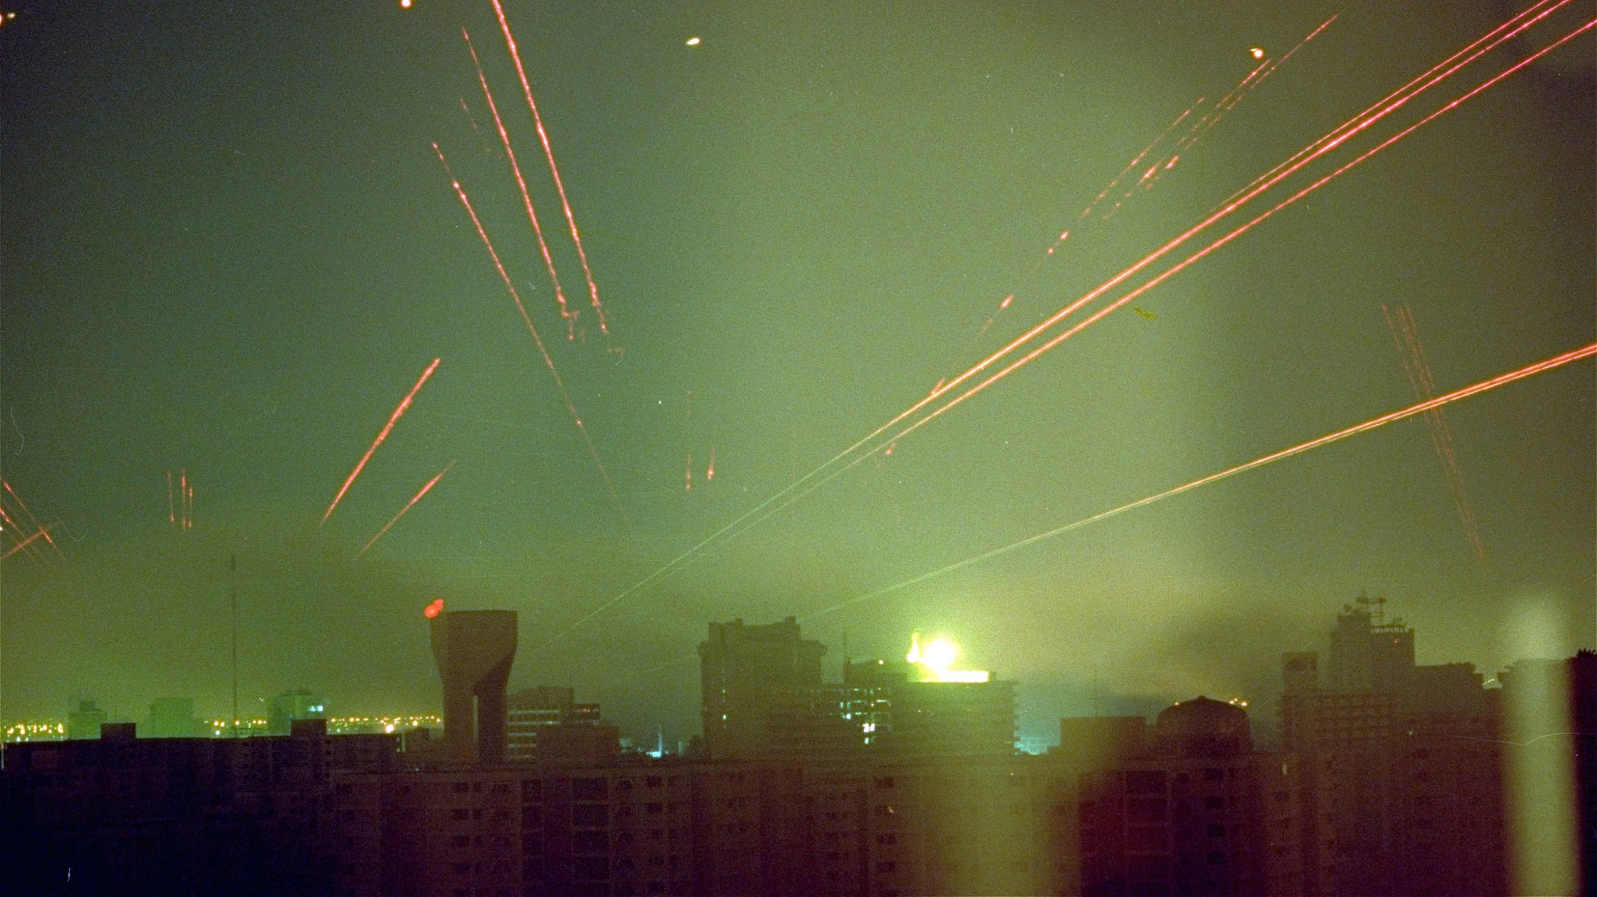
20th Century Warfare
The Gulf Wars Saw the first precision wars
Importance was laid upon knocking out enemy Command and Control Operations and other communications. The use of missiles and more precision artillery made this possible.
However, the massive use of tanks and planes represented conventional World War II strategy and tactics employing more modern equipment.
The Iraqi use of Scud Missiles demonstrated a weakness that NATO had NOT accounted for. Despite the press to the contrary, the Patriot Missile Batteries did not knock out very many missiles.
The Israeli “Iron Dome” did a little better taking the Patriot System and improving on it.

Slide 22
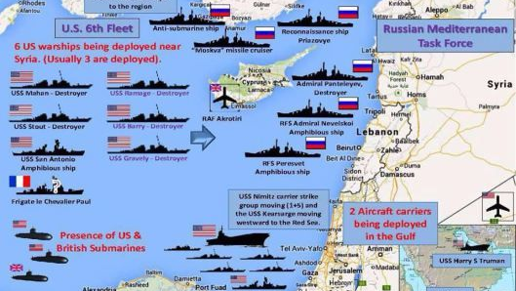
21st Century Warfare
Syria and Ukraine are Turning Out to be Different Wars
Russian operations in these two wars are showing a different outlook on how wars will be fought in the 21st century.
The Russians used precision hypersonic missiles in Syria to knock out ISIL command and control structures followed by massive infantry “mop-up” operations. They were able to keep Dr. Assad in power and to maintain their Naval Base in Tartus, Syria. This is the only warm-water port the Russians have in the West.

Slide 23
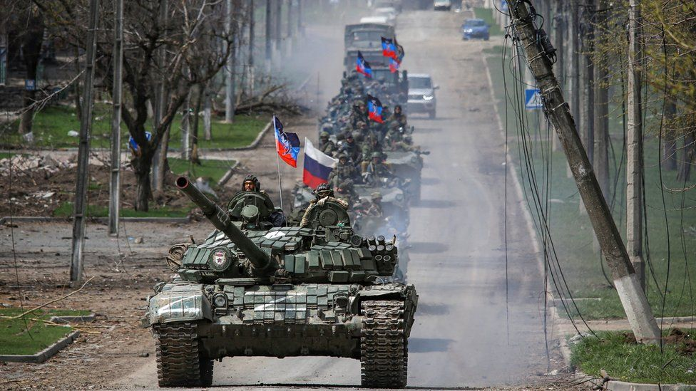
21st Century Warfare
Syria and Ukraine are Turning Out to be Different Wars
Russian operations are showing a different outlook on how wars will be fought in the 21st century.
Russia tried to operate a “gentler war” but the Asov Brigade, a group of leftover SS-trained Nazis wanted to refight World War II.
NATO has attempted to resupply Ukrainian forces with little success.
It was reported that U.S. intelligence helped the Ukraine sink a couple of Russian ships, though the Pentagon has denied this. However, the CIA has remained silent.
Could we be seeing an escalation of this War???

Slide 24
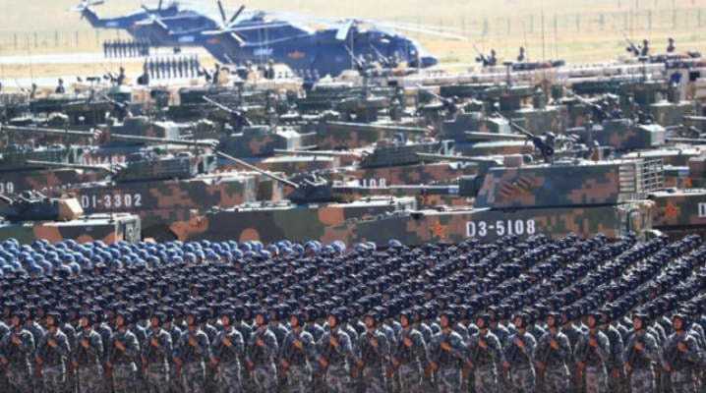
21st Century Warfare
Lessons from Afghanistan, Syria, and Ukraine
Russia has also learned, both from World War II and Afghanistan that once you take territory, you hold it, and you set up your own government on it.
In Syria, when they took land, they had Assad’s government come in and assert control over it.
In Ukraine, Russian civil authorities have come into the Donbass Region and set up a local government. The locals have welcomed them with open arms.

Slide 25

21st Century Warfare
Lessons from Afghanistan, Syria, and Ukraine
Uncontrolled reporters of the Ukraine War:
https://thedreizinreport.com/
https://liveuamap.com/ War Map of the Ukraine Region
https://www.youtube.com/c/TheNewAtlas/featured Interesting News Site
The Duran
https://www.youtube.com/c/TheDuran
https://theduran.locals.com/
https://odysee.com/@theduran:e
The Grayzone
https://www.youtube.com/channel/UCEXR8pRTkE2vFeJePNe9UcQ

Slide 26
21st Century Warfare
Russian Warfare in the 21st Century
So Far, all wars in the 21st century have been regional conflicts.
Russia is the only country truly preparing for a world war conflict.
Si vis pacem, para bellum Publius Vegetius Renatus, De re militari, 4th Century
Translation: If you want peace, prepare for war.
Russia is learning to fight a more tactical war. Their officers in the field have more authority than their NATO counterparts. They have learned that decentralized command structures are more flexible in combat situations.
They have strengthened their currency by backing the Ruble with gold. Since they did that, the Ruble has gone from 80 Rubles to the dollar on February 22, 2022, up to 138.7150 on March 10, 2022, down to 57.8250 Rubles to the dollar on May 23, 2022.

Slide 27
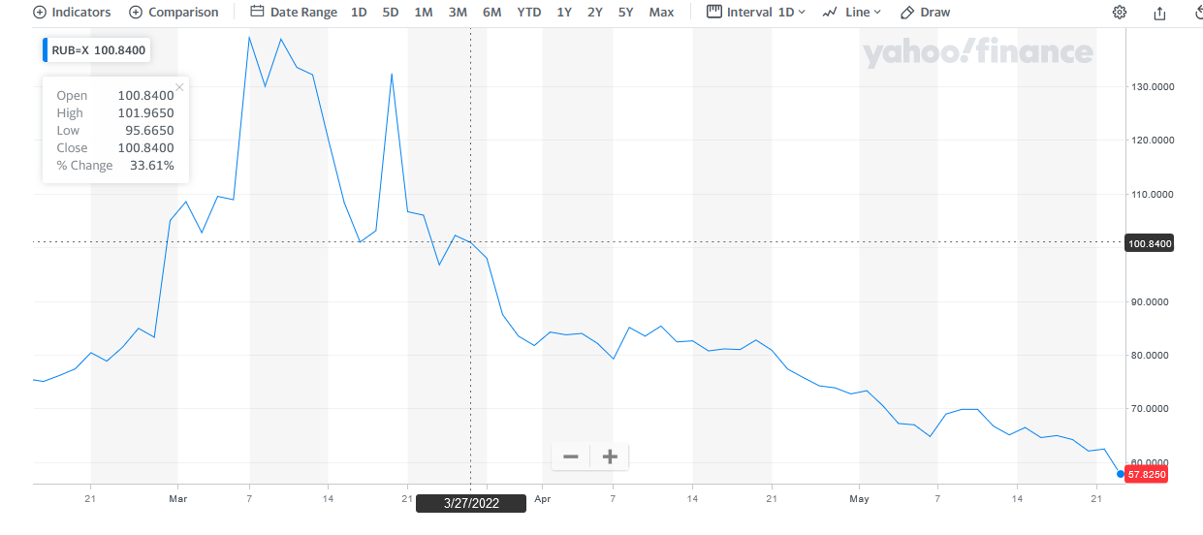
21st Century Warfare
Russian Ruble to U.S. Dollar Chart

Slide 28
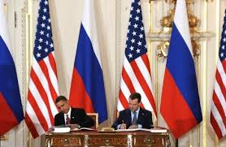
21st Century Warfare
Russian Warfare in the 21st Century
On February 5, 2011, the United States and Russia signed a New START Treaty limiting and reducing “Strategic Offensive Arms” to:
700 Deployed Intercontinental Ballistic Missiles (ICBMs)
1,550 Nuclear Warheads
800 Deployed and Non-Deployed ICBM Launchers
Notice: Where is Vladimir Putin?
Why would Russia sign a Treaty like this???

Slide 29
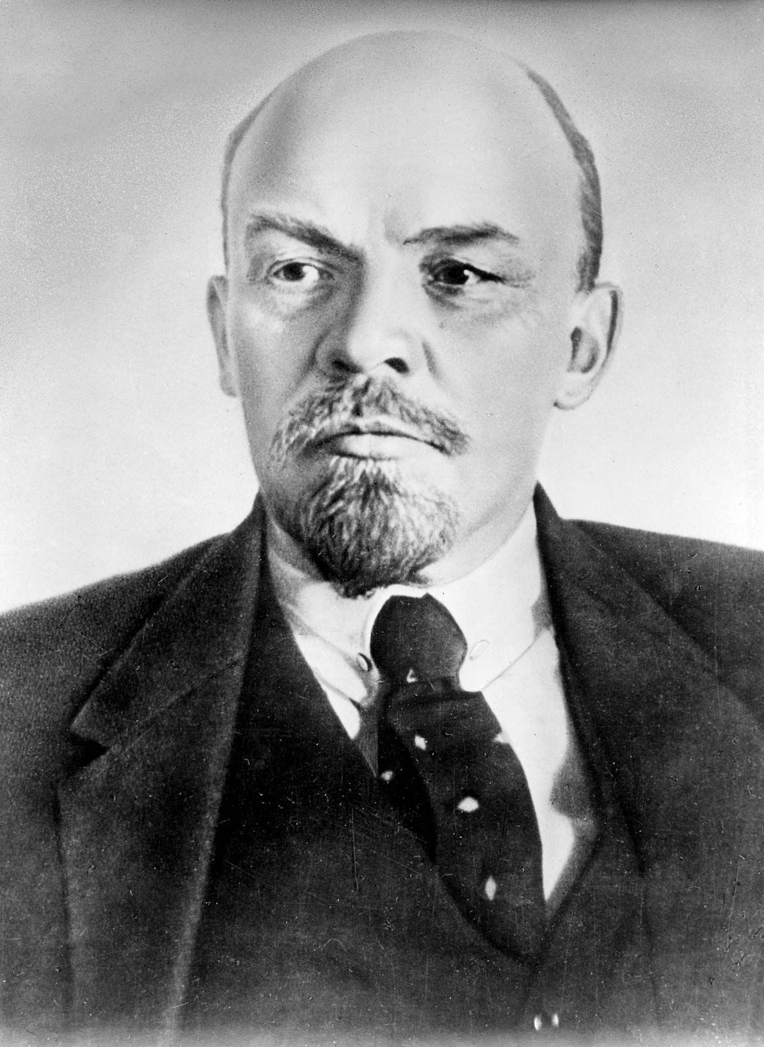
21st Century Warfare
Russian Warfare in the 21st Century
Russia would only sign a treaty like this one if they had an alternative offensive weapons system ready to take its place.
Every treaty the Russians ever made with the USA has always given the Russians an advantage.
“Treaties are like piecrust, made to be broken.” Vladimir Lenin
Treaties are tools used by politicians to advance their own purposes.

Slide 30
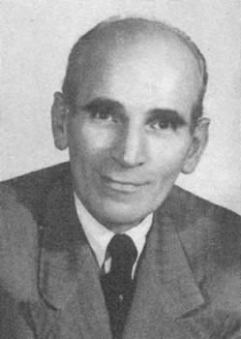
21st Century Warfare
Russian Warfare in the 21st Century
After World War II, the Russians were also part of the race to obtain German Technology.
The Russians initiated Operation Osoaviakhim to bring 2,200 technical specialists to the Soviet Union.
What Most Observers Fail to Understand is that the Nazis had a plan for how they out apportion their technology to the Allies.
On August 10, 1944, the ϟϟ organized a meeting at the Hotel Maison Rouge in Strasbourg, France. Every major industrialist was in attendance at that meeting.
Lt. General Dr. Otto Schied chaired the meeting.

Slide 31
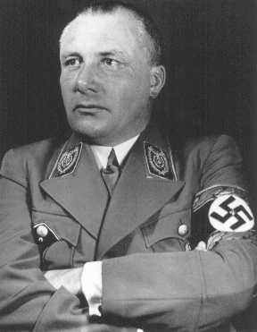
21st Century Warfare
Russian Warfare in the 21st Century
This meeting at the Hotel Maison Rouge in Strasbourg, France was under very heavy guard using top SS men with orders to “shoot first, ask questions later! "Allied forces were just 100 miles west of this location when the meeting was going on.
The plan, probably designed by Dr. Schied and Martin Borman called for an allocation of technology between the United States, Great Britain and France, and the Soviet Union. They would form 700-800 corporations to assist in the allocation of this technology.

Slide 32
21st Century Warfare
The Goal of the ϞϞ was to allocate their technology evenly between the West and the Soviet Union so as to create a Cold War that would last for decades.
The Technology Allocated to the Soviet Union was Radar Technology discovered after their Disaster at Hamburg.
The Germans applied the Electro-Magnetic Theories of James Clerk Maxwell (1831-1879) to their radar technology.
The Germans mostly used this technology against the Soviet Union because their air force was not as advanced as the United States’ and Great Britain’s air forces were.

Slide 33
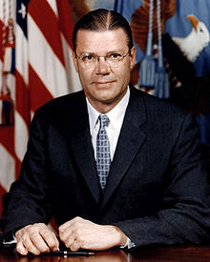
21st Century Warfare
The Soviet Union was allocated this Radar Technology after the War.
Scientists from the Soviet Union used this technology to create Scalar Magnetics in an effort to nullify the Nuclear Missiles of the United States and Great Britain.
While the Soviet Union was advancing technology using Maxwell’s Theory of the Unification of Electricity with Magnetism, the West relied on Nuclear Technology and Robert McNamara’s “Mutually Assured Destruction”(MAD) Theory as a deterrent to Nuclear War.
Robert McNamara
B.A. Cal-Berkeley
M.B.A., Harvard

Slide 34
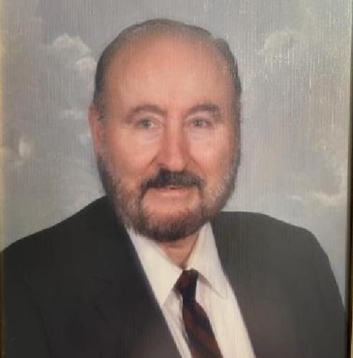
21st Century Warfare
Russian Warfare in the 21st Century
By the 1980s the Soviet Union had perfected Directed Energy Weapons which could target Nuclear Weapons and detonate them on the launch pad. It is no wonder they could care less about limitations on their ICBMs, they were not part of their war planning.
In 1988, Lt. Col. Thomas Bearden revealed to a meeting of scientists, the existence of these weapons.
BitCute Link
Odysee Link
Considering How Controversial this Video is, we have retained a copy. It has been loaded on the Alive on the Edge Website. It will be loaded on the WhiteStone Foundation Website soon.
Lt. Col. Tom Bearden
B.S. N.E. Louisiana
M.S. Georgia Tech
He died on February 3, 2022

Slide 35


21st Century Warfare
Russian Warfare in the 21st Century
Could Lt. Col. Bearden be on to something?
In the video game, Command and Conquer, the Soviet Union used this weapon:
Lt. Col. Tom Bearden
B.S. N.E. Louisiana
M.S. Georgia Tech
He died on February 3, 2022

Slide 36
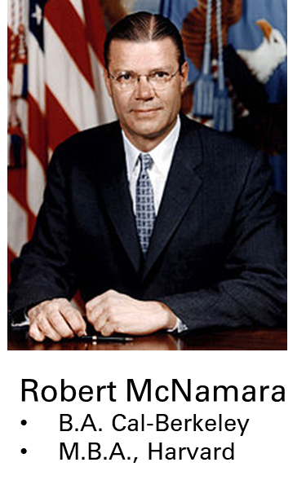
21st Century Warfare
Russian Warfare in the 21st Century
Lt. Col. Bearden explained that Dr. Vlail Kaznacheyev and his team of Soviet Scientists had perfected a Phase Conjugate Wave that could pinpoint the location of any country’s nuclear arsenal and detonate it onsite, rendering it useless for that nation.
The West is far behind Russia in the development of Electromagnetics, depending upon the Mutually Assured Destruction (MAD) theories of Robert McNamara.

Slide 37
21st Century Warfare
Russian Warfare in the 21st Century
Contrary to mainstream news reports, the Russians have effectively taken over the Donbas region and intend to annex that region into Russia. (We will share sources with you on another slide)
The Ukrainian Army has been stifled and cannot move. Therefore, they are “sitting ducks” for Russian firepower. The only effective Ukrainian fighting units are the Asov Brigades, which were trained by the SS, both during and after World War II. The Central Intelligence Agency (CIA) has financed a lot of that training.

Slide 38
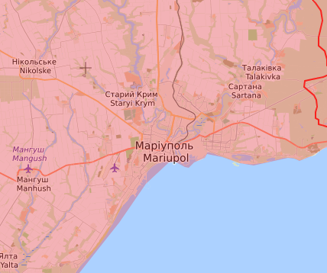
21st Century Warfare
The Russians are now in full-control of Mariupol, a coastal city on the Ukranian coast of the Black Sea.

Slide 39
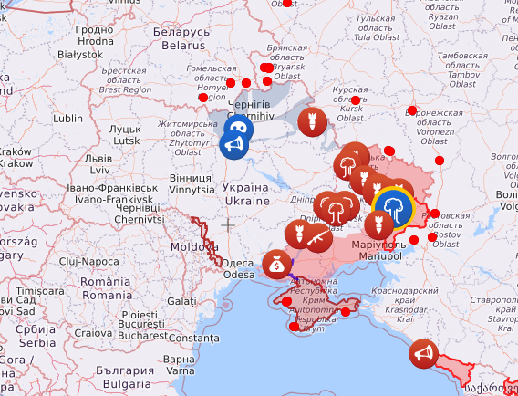
21st Century Warfare
The Russians have gained control of the Eastern Ukraine and are moving westward. They are moving to cut off all supply efforts on the Black Sea. Air raid sirens have been blowing all over east central Ukraine, suggesting the Russians will move in this area next.

Slide 40
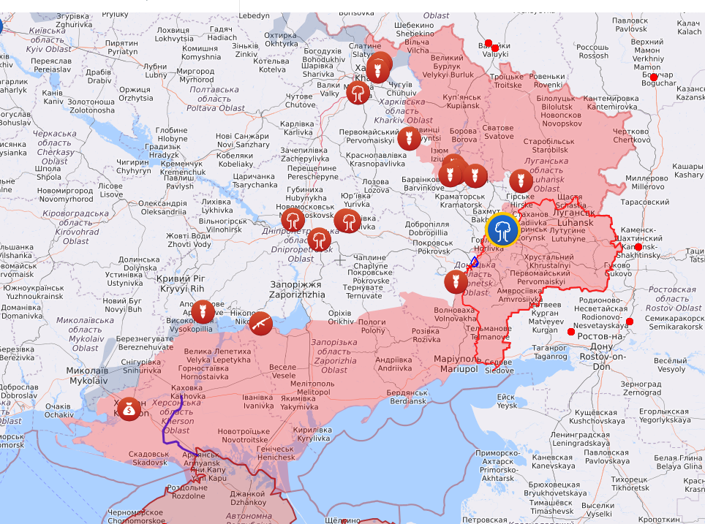
21st Century Warfare
This is the Donbas region of the Ukraine. Most of it has been captured by the Russians. It appears the Russians are preparing to move westward. We are expecting the Russians to move westward.

Slide 41
21st Century Warfare
Western Responses to Russian Warfare
The effectiveness of Western fighting units has decreased significantly the past few decades.
Many good officers of all ranks have been mustered out, leaving our armed forces weak and ineffective.
NATO leadership is vacillating and ineffective, unable to lead any kind of war.
In Ukraine, many NATO advisors have been killed and NATO weapons have proven ineffective in stopping Russian armor, much of it dating back to the 1990s.
Even though the main steam media of many western countries have advocated sending in troops, doing so would be disastrous.

Slide 42
The Black Horse’s Players
Who are the Nations That Will Participate in These Wars?

Slide 43
21st Century Warfare
Biblical Insight into the Black Horse of War
The Book of Daniel Outlines the Players of this War
The first was like a lion and had eagle’s wings: I beheld till the wings thereof were plucked, and it was lifted up from the earth, and made stand upon the feet as a man, and a man’s heart was given to it.
And behold another beast, a second, like to a bear, and it raised up itself on one side, and it had three ribs in the mouth of it between the teeth of it: and they said thus unto it, Arise, devour much flesh.
After this I beheld, and lo another, like a leopard, which had upon the back of it four wings of a fowl; the beast had also four heads; and dominion was given to it. (Daniel 7:4-6 KJB:PCE)

Slide 44
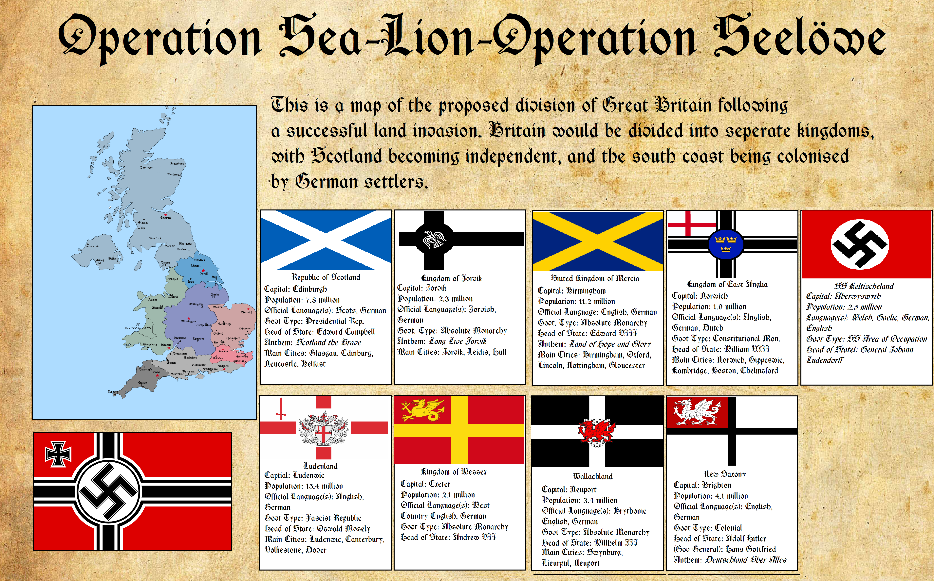
21st Century Warfare
Biblical Insight into the Black Horse of War
The Book of Daniel Outlines the Players of this War – The Lion with Eagle’s Wings
Nazi Germany’s Plan to Invade Great Britain was code named: Operation Sea Lion.
They planned to make Scotland an independent republic.
The rest of England and Wales would be broken into eight kingdom with southern England occupied by German Settlers.

Slide 45
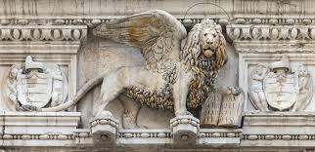
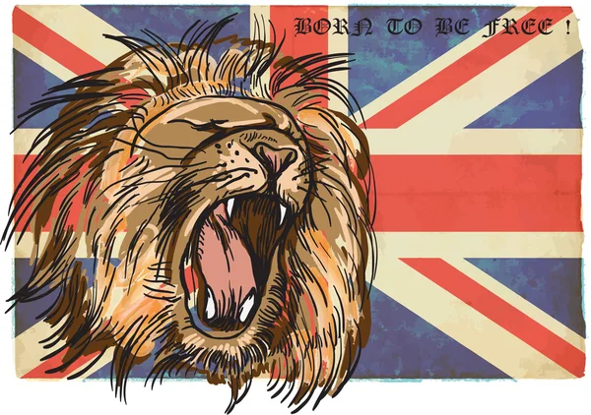
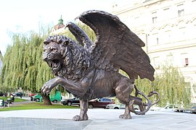
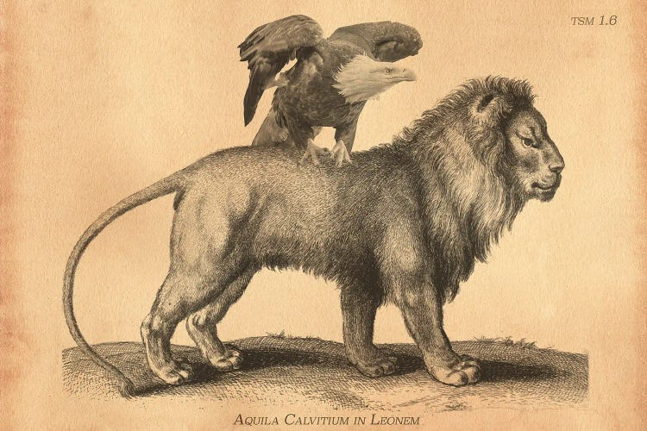
21st Century Warfare
Biblical Insight into the Black Horse of War
The Book of Daniel Outlines the Players of this War – The Lion with Eagle’s Wings
The symbology of Great Britain.

Slide 46



21st Century Warfare
Biblical Insight into the Black Horse of War
The Book of Daniel Outlines the Players of this War – The Lion with Eagle’s Wings
The symbology of the United States.

Slide 47



21st Century Warfare
Biblical Insight into the Black Horse of War
The Book of Daniel Outlines the Players of this War – The Lion with Eagle’s Wings
The symbology of the Germany.

Slide 48
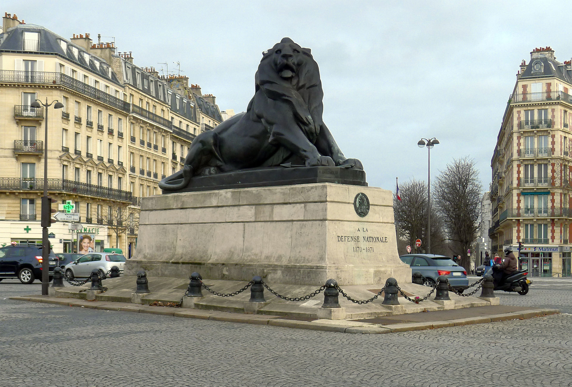


21st Century Warfare
Biblical Insight into the Black Horse of War
The Book of Daniel Outlines the Players of this War – The Lion with Eagle’s Wings
The symbology of the France.

Slide 49

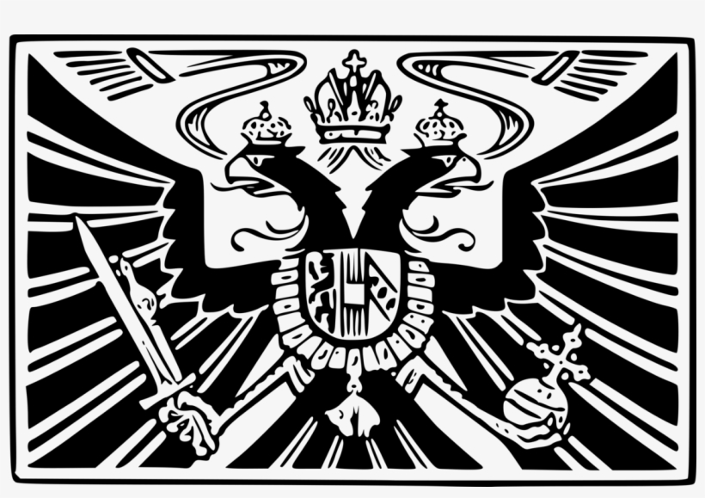

21st Century Warfare
Biblical Insight into the Black Horse of War
The Book of Daniel Outlines the Players of this War – The Lion with Eagle’s Wings
The symbology of the Austria.

Slide 50

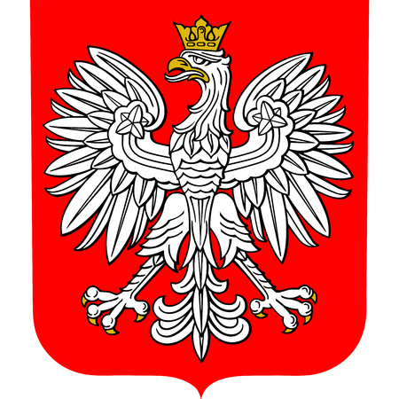
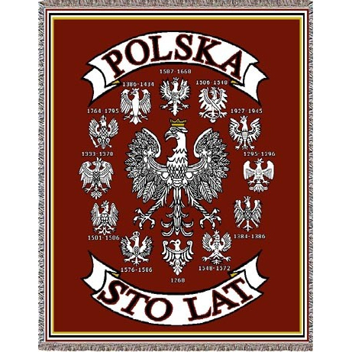
21st Century Warfare
Biblical Insight into the Black Horse of War
The Book of Daniel Outlines the Players of this War – The Lion with Eagle’s Wings
The symbology of the Poland.

Slide 51


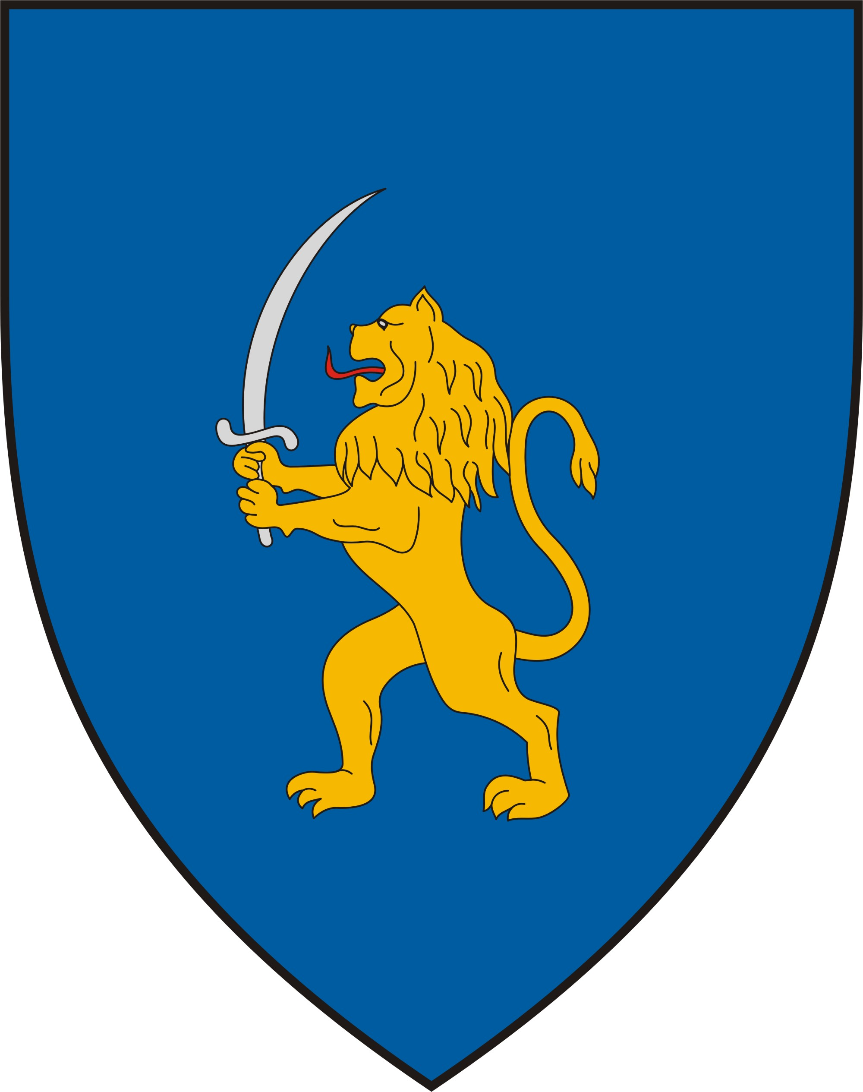

21st Century Warfare
Biblical Insight into the Black Horse of War
The Book of Daniel Outlines the Players of this War – The Lion with Eagle’s Wings
The symbology of the Hungary.

Slide 52

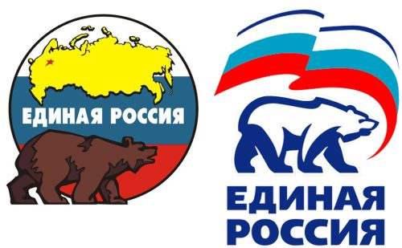
21st Century Warfare
Biblical Insight into the Black Horse of War
The Book of Daniel Outlines the Players of this War – The Bear
The symbology of the Russia.

Slide 53

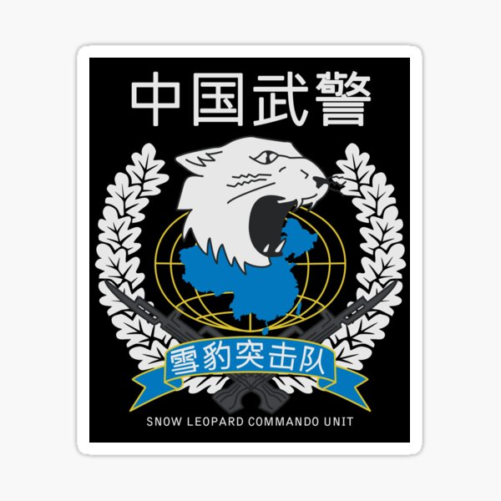

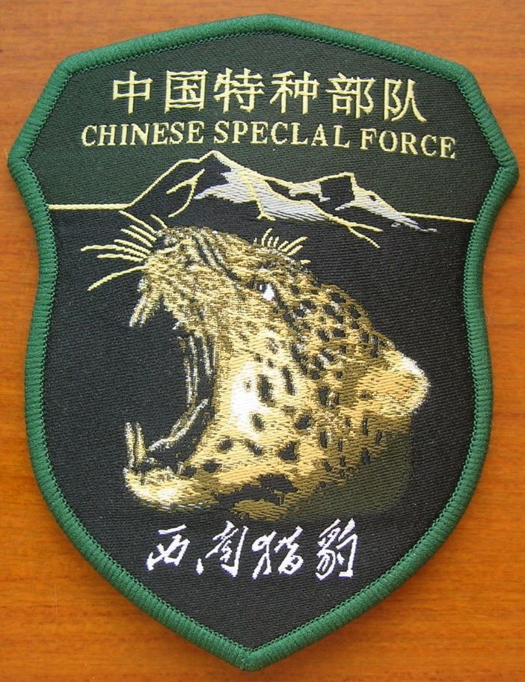
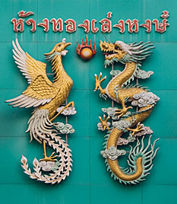
21st Century Warfare
Biblical Insight into the Black Horse of War
The Book of Daniel Outlines the Players of this War – The Bear
The symbology of the China.

Slide 54

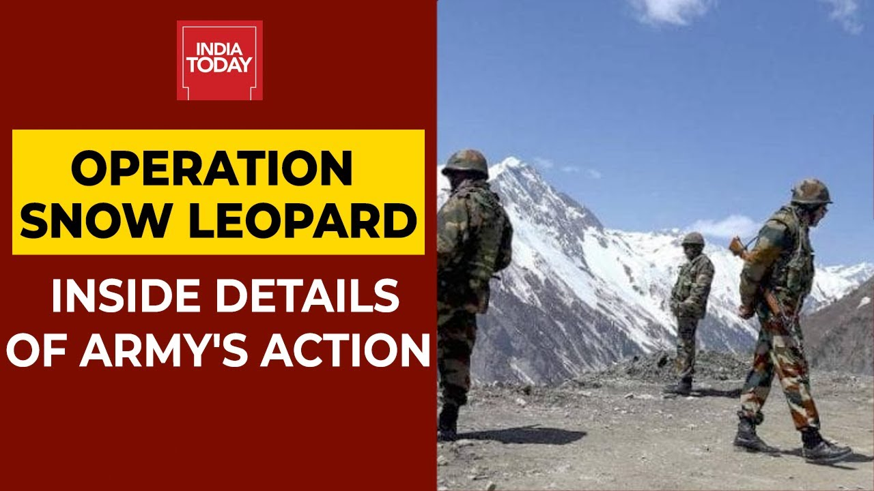
21st Century Warfare
Biblical Insight into the Black Horse of War
The Book of Daniel Outlines the Players of this War – The Bear
The symbology of the India.

Slide 55

“Sī vīs pācem, parā bellum…” “If you want peace, prepare for war…”
Publius Vegetius Renatus
(fourth or fifth century A.D.)

Slide 56




Thank You
Prof. Tom Mack (ret.)
tom.mack@whitestonefoundation.org
http://whitestonefoundation.org
Major Tom Baird (ret.)
tom@aliveontheedge.com
http://aliveontheedge.com

